Slide 1

Authentication Using OpenID Connect and OAuth2
Mark A. Wilson Senior Developer MarkW@LogicalAdvantage.com
www.DeveloperInfra.com @DeveloperInfra

Slide 2

Mark A. Wilson
www.developerinfra.com
@DeveloperInfra
Software craftsman, consultant and agile .NET/JavaScript web developer. User group leader and event planner. Loving husband, dog foster, and Disney aficionado.
Notes:
17 notable references in Wikipedia.

Slide 3


Logical Advantage
www.logicaladvantage.com
Our mission is to partner with our clients to provide strategies and solutions that maximize the ROI of Enterprise Asset Intelligence and Human Capital Development.
Notes:
Business cards up front.

Slide 4
Authentication Using Tokens for AngularJS, OWIN, ASP.NET Web API & Identity

Slide 5
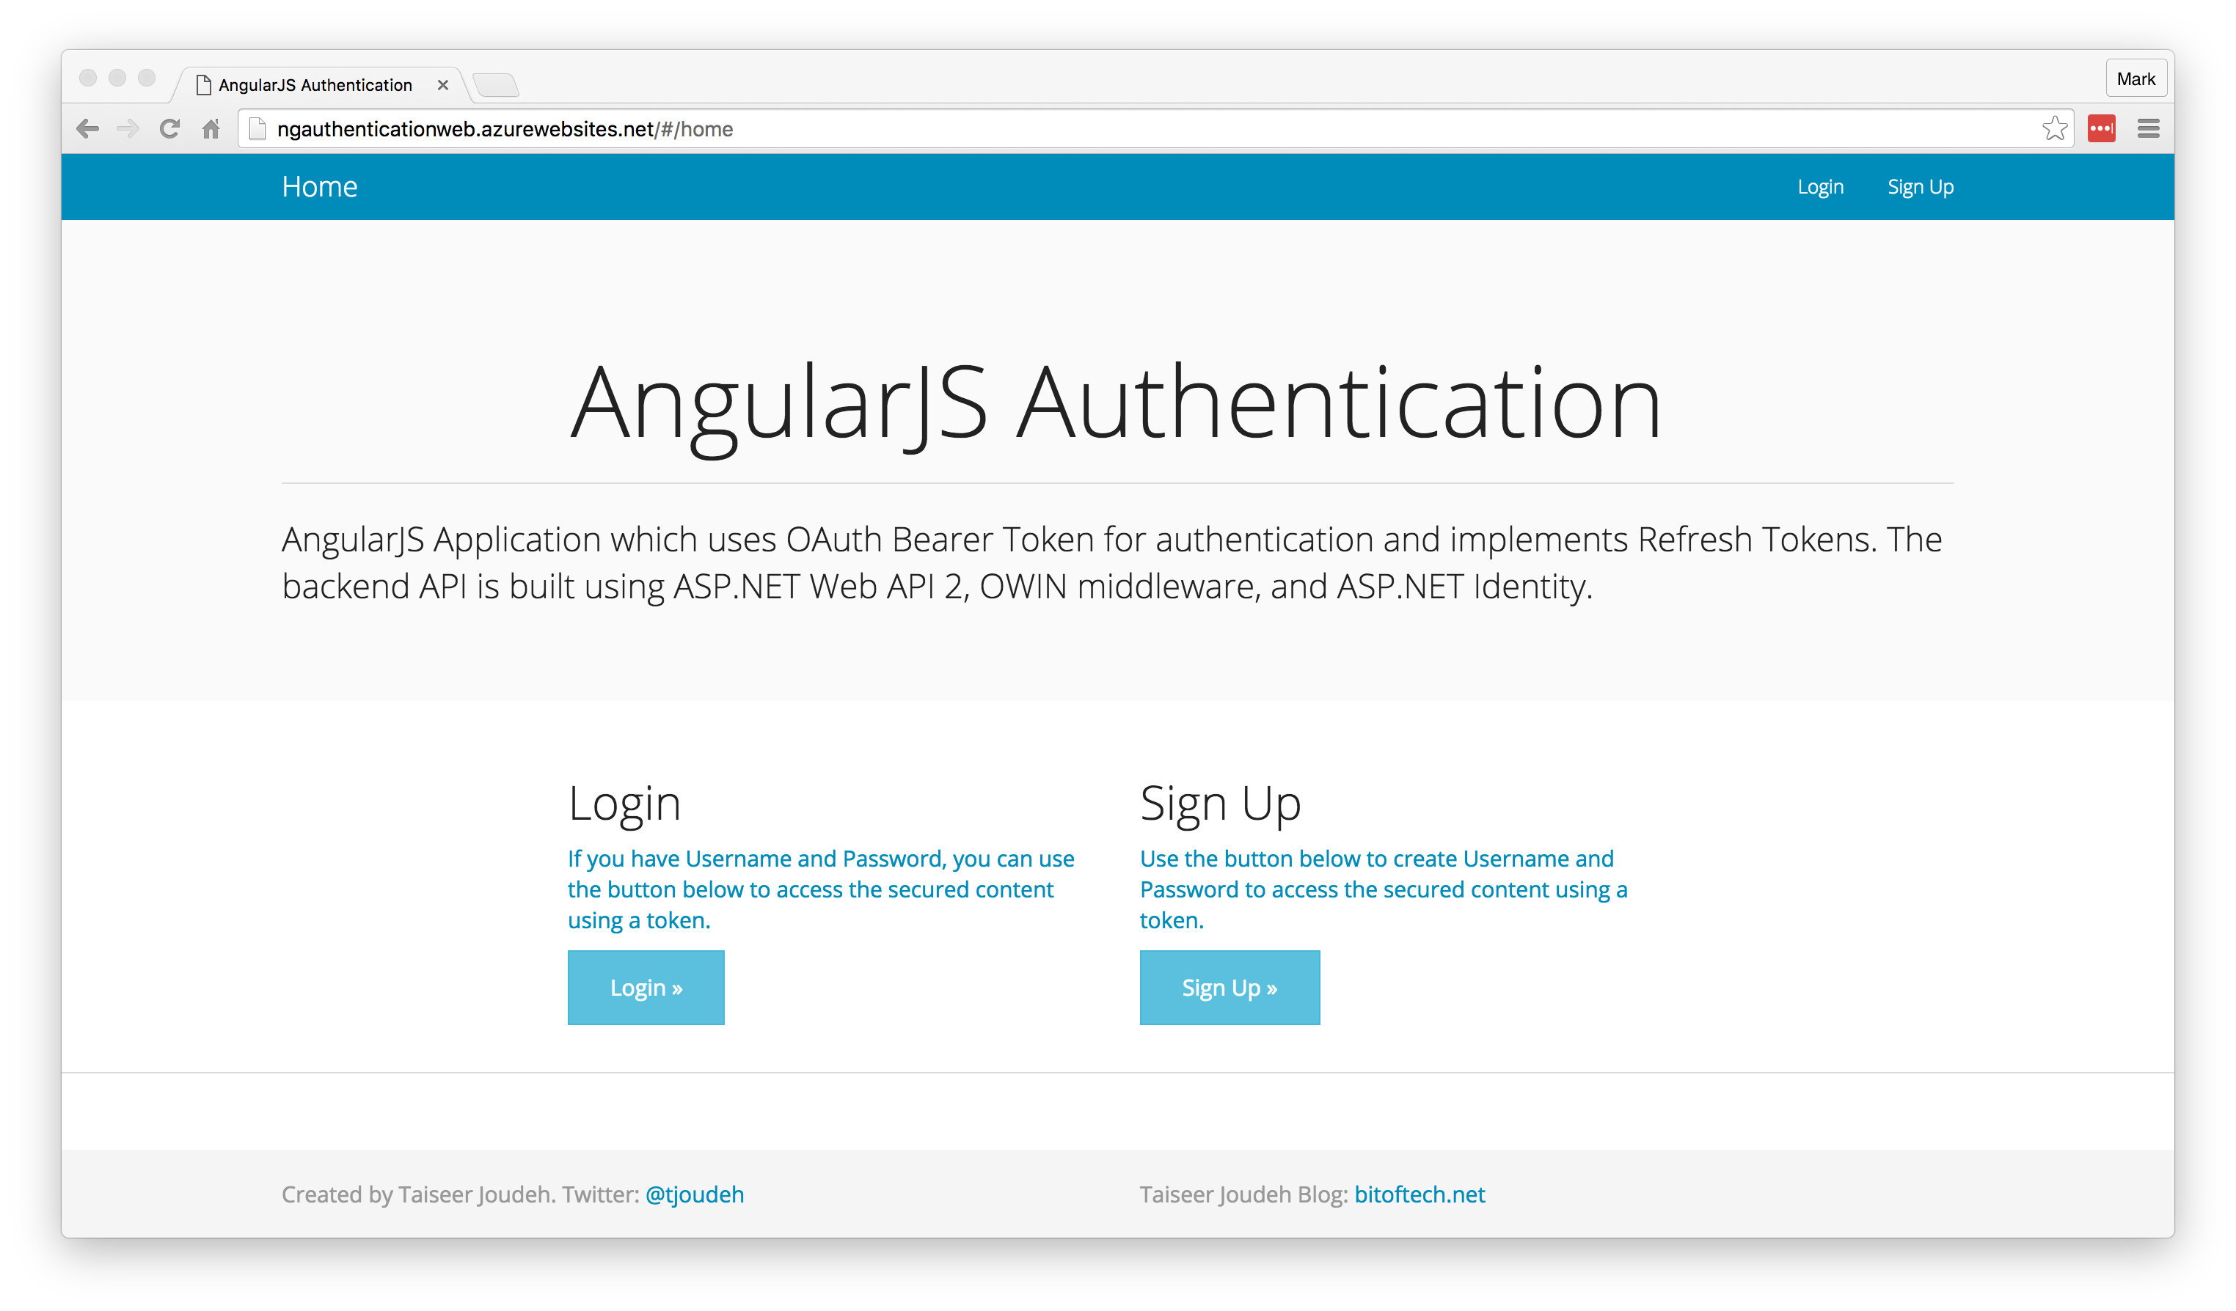
AngularJS Authentication Demo
http://bitoftech.net/2014/06/01/token-based-authentication-asp-net-web-api-2-owin-asp-net-identity/

Slide 6
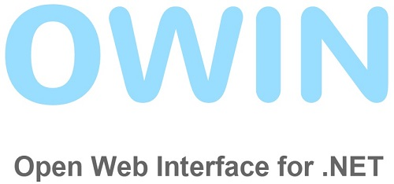
Open Web Interface for .NET
A specification, not a framework
A standard for an interface between .NET web applications and web servers
Decouple the application from the [IIS] server
Encourage development of simple and lightweight modules
Project Katana is OWIN implementations for Microsoft servers and frameworks
https://en.wikipedia.org/wiki/Open_Web_Interface_for_.NET

Slide 7
Project Katana
A set of OWIN components built by Microsoft
Enables ASP.NET applications to be flexible, portable, lightweight, and provide better performance
Host – An executable process
Server – Opens network sockets
Middleware – Pipeline of OWIN components
Application – Your code
Application
Middleware
Server
Host
http://www.asp.net/aspnet/overview/owin-and-katana/an-overview-of-project-katana

Slide 8

OAuth 2.0
Authorization framework
Began in November 2006 when Blaine Cook was developing the Twitter OpenID implementation
OAuth 1.0 – April 2010
OAuth 2.0 – October 2012
Allows access tokens be issued to third-party clients/websites
Not without its critics and controversy
https://en.wikipedia.org/wiki/OAuth

Slide 9
OAuth 2.0
Does not support signature, encryption, channel binding, or client verification.
Relies completely on Transport Layer Security (TLS) / Secure Sockets Layer (SSL).
“Covert Redirect” involving the redirect_uri.
Phishing site attacks.
Eran Hammer resigned as lead author in July 2012.
“OAuth 2.0 is not an authentication protocol.”
https://en.wikipedia.org/wiki/OAuth

Slide 10
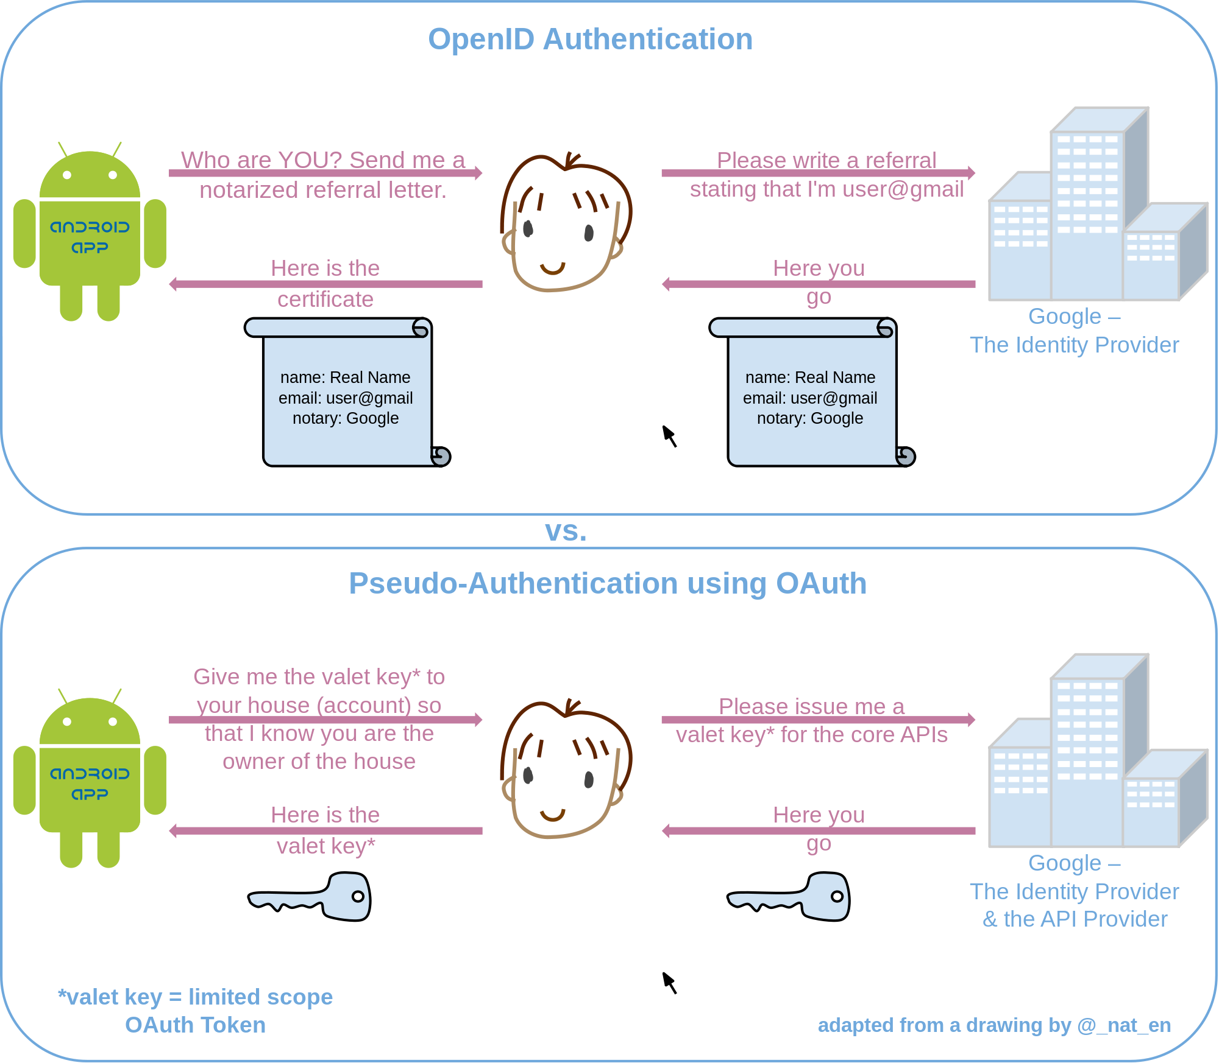
Pseudo-Authentication using OAuth
https://en.wikipedia.org/wiki/OAuth

Slide 11

Project Katana
”vNext is the successor to Katana (which is why they look so similar). Katana was the beginning of the break away from System.Web and to more modular components for the web stack.”
– David Fowler ASP.NET Core Architect
http://forums.asp.net/t/2004299.aspx?Katana%20VS%20vNext

Slide 12
Is it worth it?
Pros
Cons
Authentication & authorization abstracted into a “component” using standard protocol (OAuth2)
Eliminated the cookie and Cross-Site Request Forgery (CSRF) problems for SPAs
Encrypted and signed tokens (using shared machine key)
SSL by default
Resource owner flow very easy.
Exponentially complex
Adding refresh tokens required implementing persistence
Implicit flow (native or JS apps) lacked login/consent view engine
Lacking in validation
The ASP.NET team decided to discontinue Project Katana to focus on consuming tokens
“Note: This outline should not be intended to be used for creating a secure production app.”
https://leastprivilege.com/2014/03/24/the-web-api-v2-oauth2-authorization-server-middlewareis-it-worth-it/

Slide 13
Modern Applications

Slide 14
This happened…
No SOAP
No SAML
No WS*
No Windows
No Enterprise

Slide 15
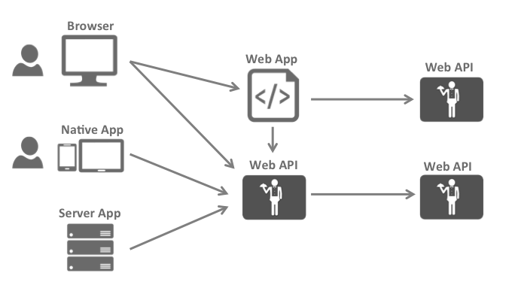
The Big Picture
https://identityserver.github.io/Documentation/docsv2/overview/bigPicture.html

Slide 16
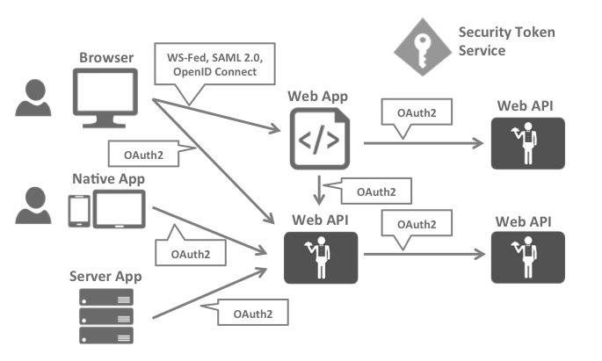
Security Protocols
https://identityserver.github.io/Documentation/docsv2/overview/bigPicture.html

Slide 17
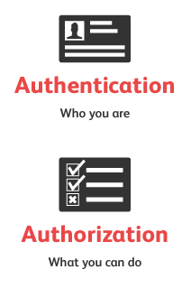
Security Concerns
Authentication
API Access
Identity of the current user
Application identity and/or delegating the user’s identity
https://identityserver.github.io/Documentation/docsv2/overview/bigPicture.html

Slide 18

Security Assertion Markup Language
Most popular & widely deployed
SAML 1.0 – November 2002
SAML 1.1 – September 2003
SAML 2.0 – March 2005
Browser single sign-on (SSO)
Problematic beyond intranet
XML-based
“Enterprisey” and “not trivial”
https://en.wikipedia.org/wiki/Security_Assertion_Markup_Language

Slide 19
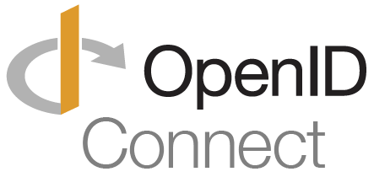
OpenID Connect
Newest but generally considered to be the future
OpenID – May 2005
OpenID 2.0 – December 2007
OIDC [3.0] – February 2014
Designed to be more usable by native and mobile applications
RESTful HTTP API using JSON
Authentication layer on top of the OAuth 2.0 authorization framework
Uses the JSON Web Token (JWT) and JSON Object Signing and Encryption (JOSE) specs
https://en.wikipedia.org/wiki/OpenID

Slide 20
https://en.wikipedia.org/wiki/OAuth

Slide 21
Better Together
https://identityserver.github.io/Documentation/docsv2/overview/bigPicture.html

Slide 22
Authentication Using OpenID Connect and OAuth2

Slide 23
OpenID Connect
“OpenID Connect 1.0 is a simple identity layer on top of the OAuth 2.0 protocol.”
Defines identity tokens
Defines standard token type
Defines standard cryptography
Defines validation procedures
Defines flows for browser, native, and server-based apps
Combines authentication with short/long-lived delegated API access
http://openid.net/connect/

Slide 24
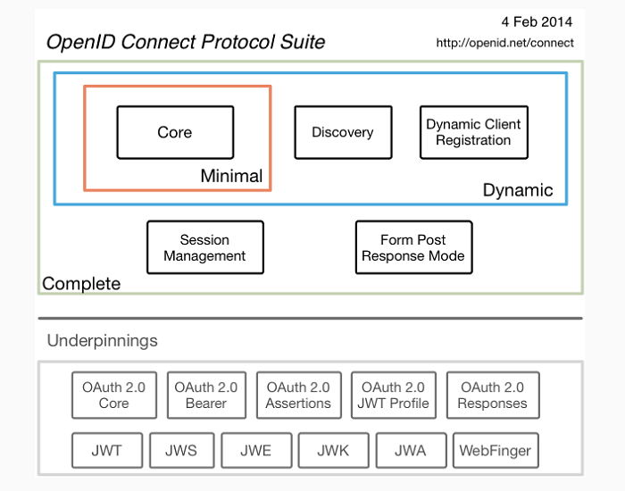
OpenID Connect
http://openid.net/connect/

Slide 25



OpenID Connect
Authorize Endpoint
Token Endpoint
UserInfo Endpoint

Slide 26

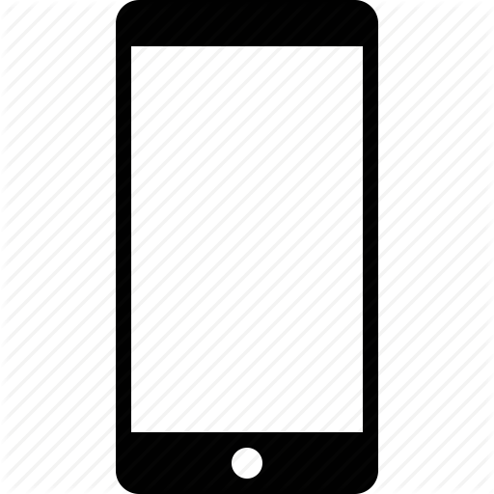

Flows
Client Credentials Flow
(Server-to-Server/IoT)
Implicit Flow
(Browser-based)
Hybrid Flow
(Native/Mobile)

Slide 27
Implicit Flow
GET /authorize
?client_id=app1
&redirect_uri=https://app.com/cb
&response_type=id_token
&response_mode=form_post
&nonce=a1b…x9z
&scope=openid email

Slide 28
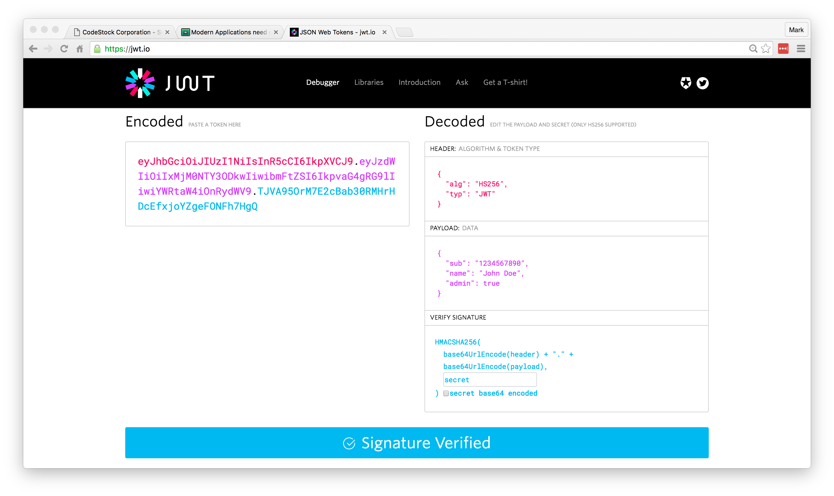
Identity Token
https://jwt.io/

Slide 29
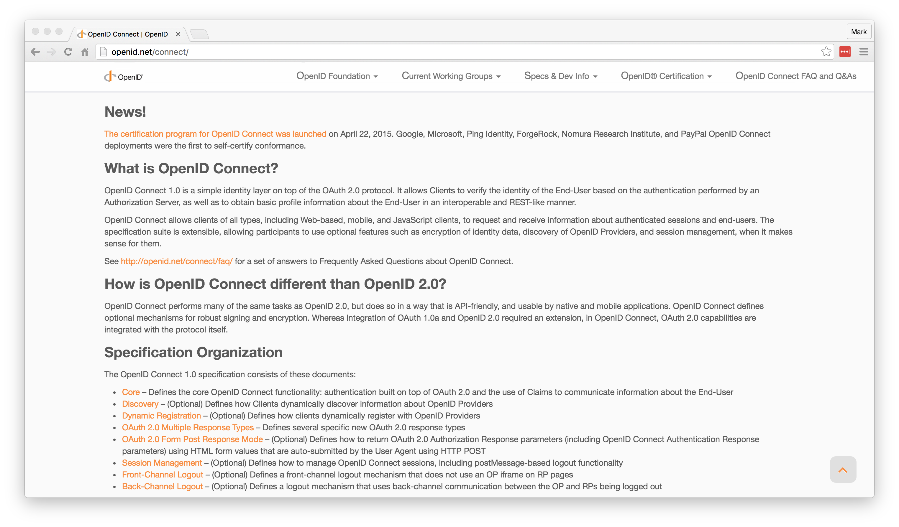
Getting Started
http://openid.net/connect/

Slide 30
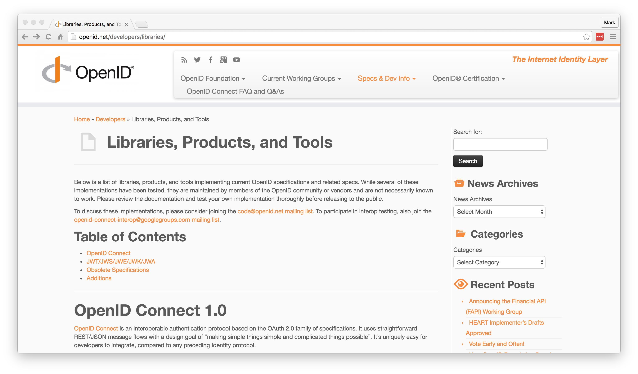
Getting Started
http://openid.net/developers/libraries/

Slide 31
IdentityServer

Slide 32
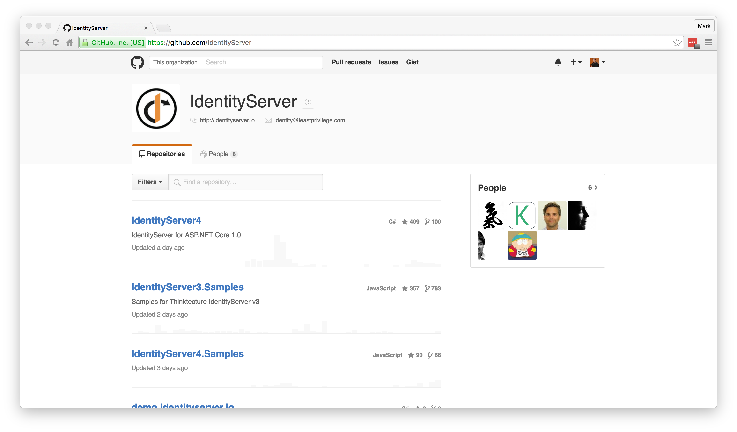
Getting Started
https://github.com/IdentityServer

Slide 33
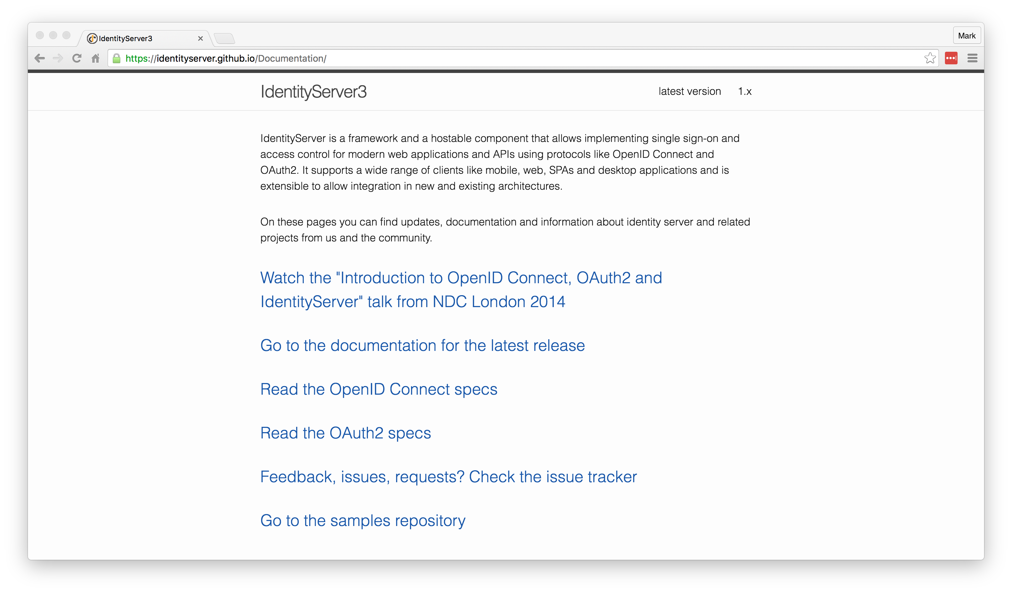
Getting Started
https://identityserver.github.io/Documentation/

Slide 34
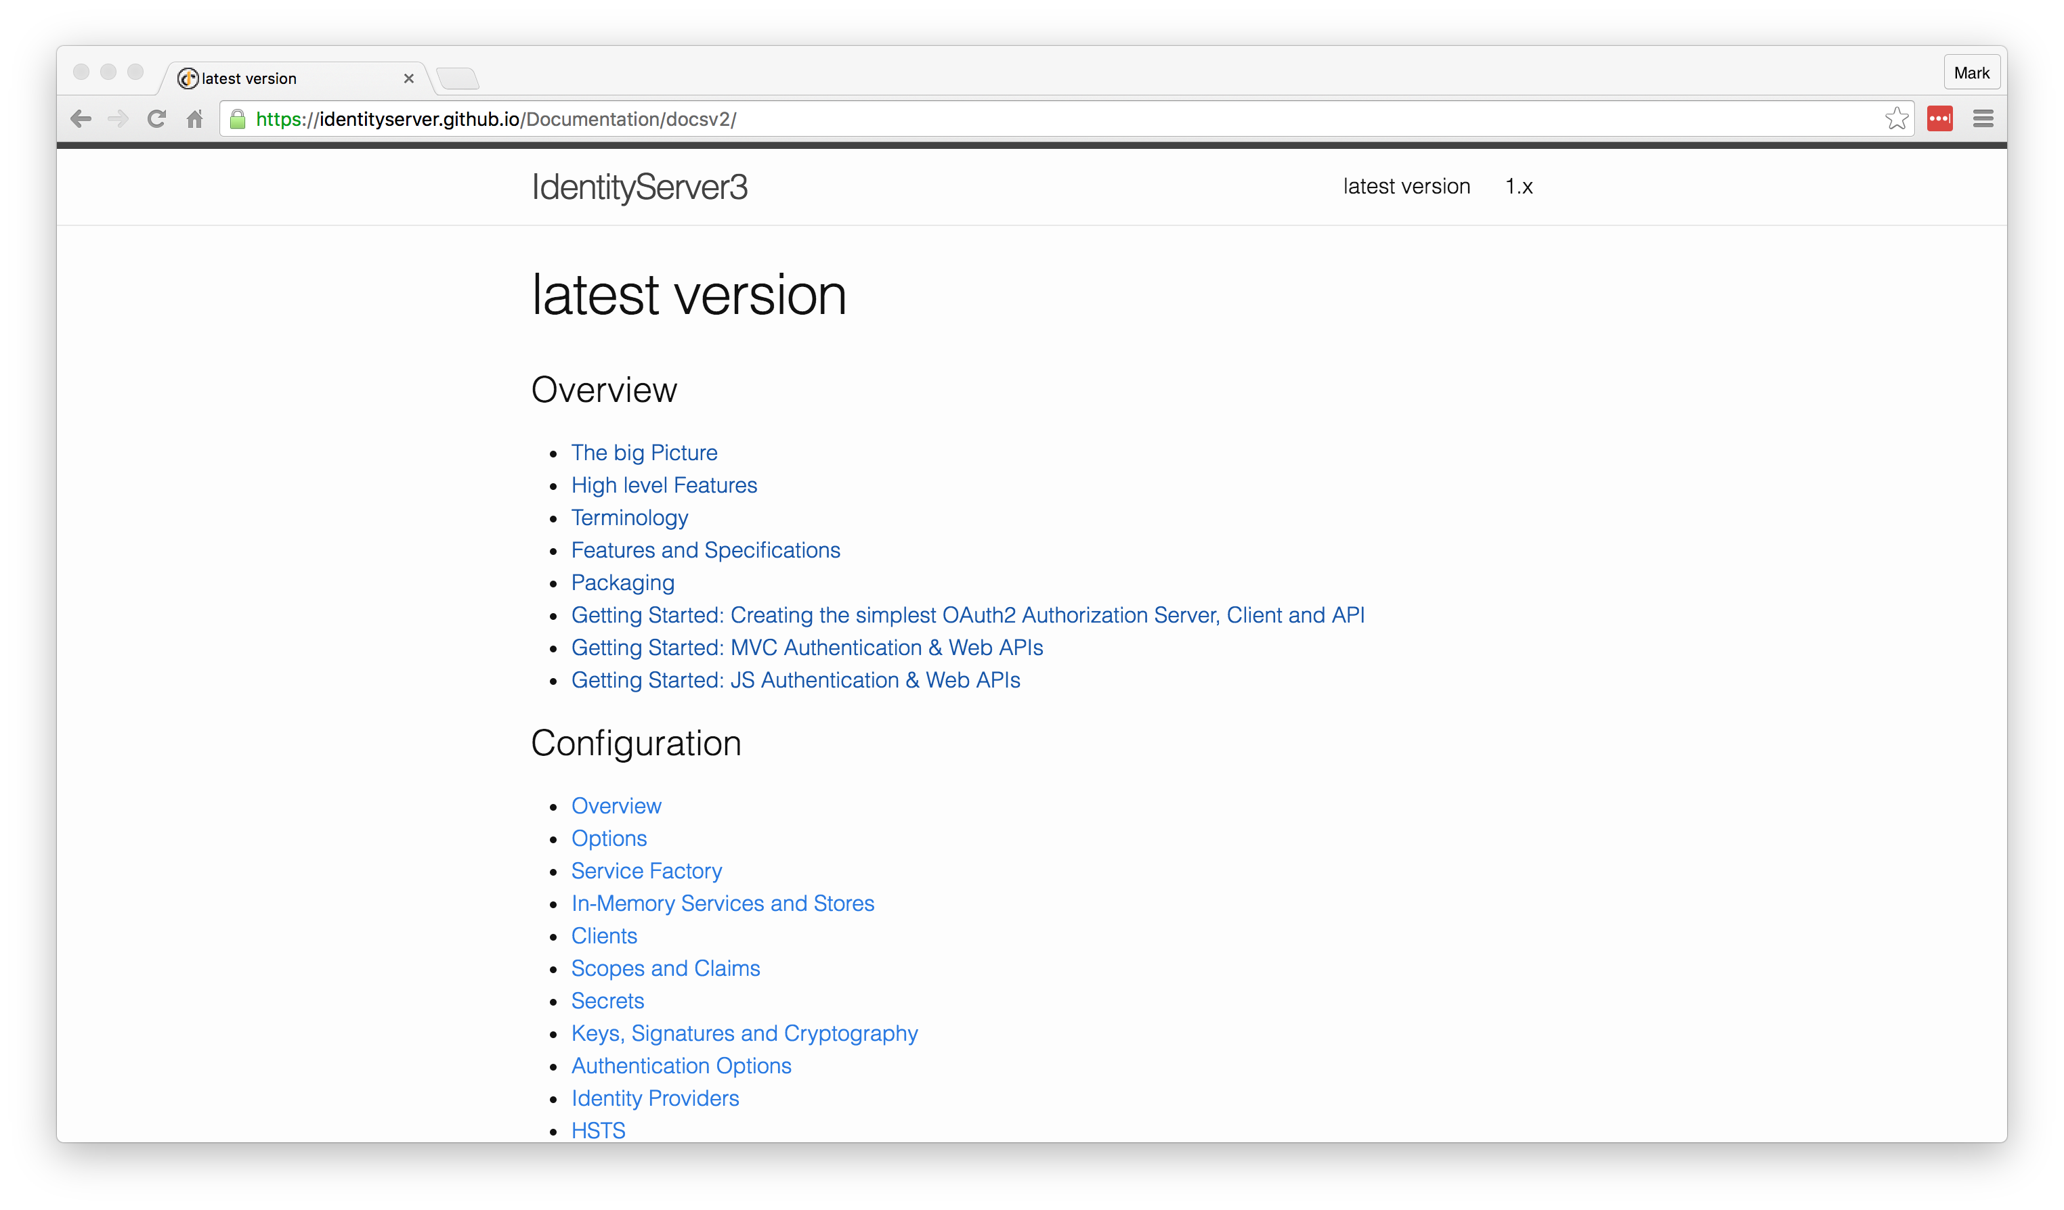
Getting Started
https://identityserver.github.io/Documentation/docsv2/

Slide 35
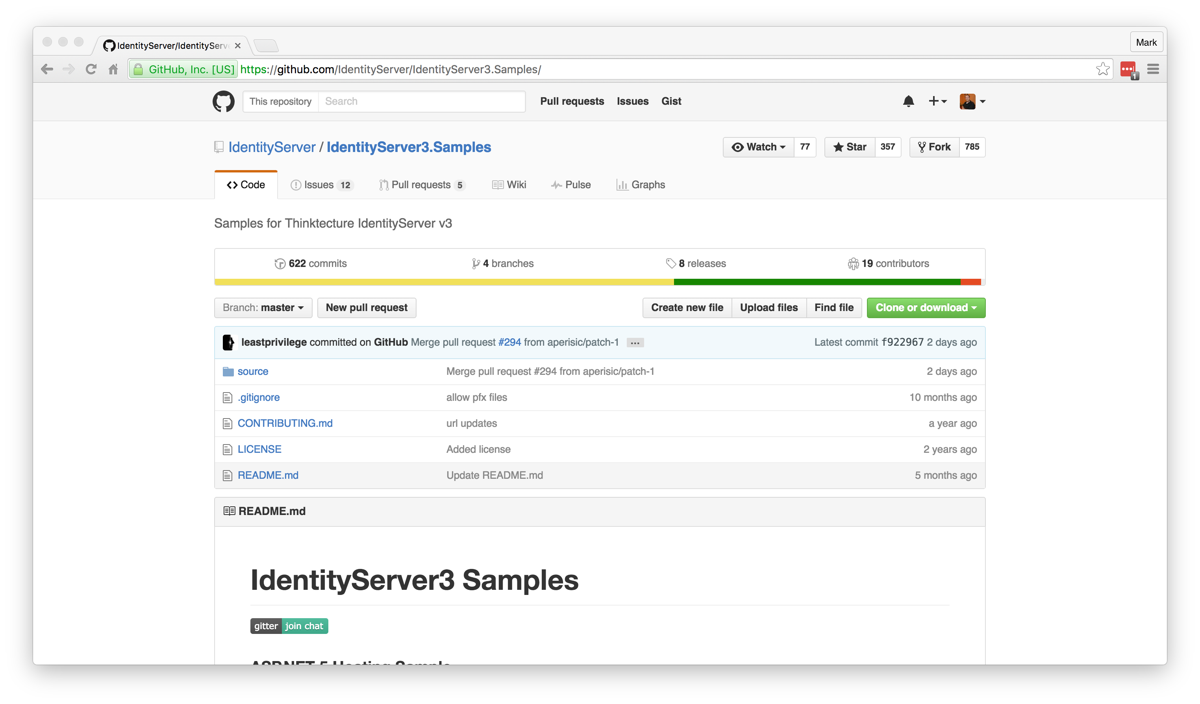
Getting Started
https://github.com/IdentityServer/IdentityServer3.Samples/

Slide 36


IdentityServer
DEMO

Slide 37
Resources
OpenID Connect: http://openid.net/connect/
OpenID Connect Libraries: http://openid.net/developers/libraries/
IdentityServer: https://github.com/IdentityServer
IdentityServer Samples: https://github.com/IdentityServer/IdentityServer3.Samples/
OAuth for ASP.NET: http://www.oauthforaspnet.com/
JSON Web Tokens: https://jwt.io/
Notes:
HTTPS: Use it!
Forms Auth: Happy path, easiest to setup. Transmits in clear text.
3rd-Party Logins: All implemented differently. Takes time.
Custom Grant Type: Forms vs. 3rd-Party take separate paths.
Entity Framework: Everything uses it by default.
Production Ready: Maybe not public-facing. Very little validation/checking.

Slide 38

Authentication Using OpenID Connect and OAuth2
Mark A. Wilson Senior Developer MarkW@LogicalAdvantage.com
www.DeveloperInfra.com @DeveloperInfra

